Slide 1
Recurrent Neural network
Date:23.09.22

Slide 2
Sequence model
Sequence models are the machine learning models that input or(and) output sequences of data.
Examples: Speech recognition
image captioning
sentiment classification
Language translation
stock market prediction
music generation

Slide 3
Why we need RNN ?
Traditional ANN can not process sequence data because of different sizes in input/output neurons.
Sequence data processing involves too much computation which ANN can not handle.
Parameter sharing is not possible in ANN.
ANN does not have internal memory to keep track of previous inputs.

Slide 4
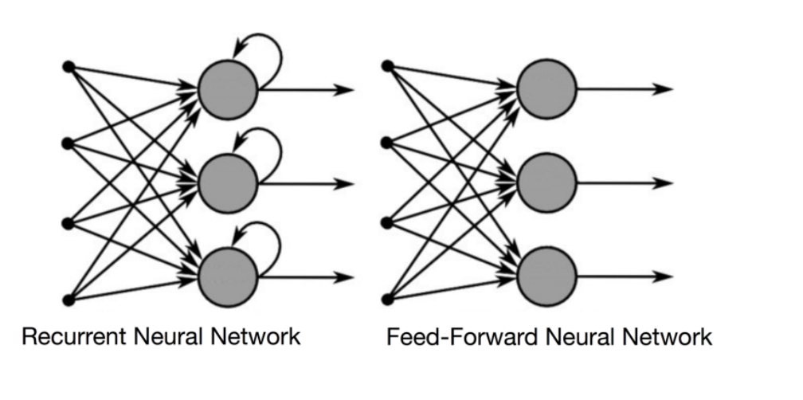
RNN vs ANN

Slide 5
RNN
A recurrent neural network (RNN) is a type of artificial neural network which uses sequential data or time series data.
Extensively used in Language translation, natural language processing (nlp), speech recognition, and image captioning ,etc
In a RNN output of the current layer is the input of the next layer.
In traditional neural networks, all the inputs and outputs are independent of each other, but in cases like when it is required to predict the next word of a sentence, the previous words are required and hence there is a need to remember the previous words(data).
In a RNN same weights and bias are used at each time step. Because it performs the same task on all the inputs of hidden layer to produce the output.
The main and most important feature of RNN is Hidden state, which remembers some information which gets used in the next layer.

Slide 6
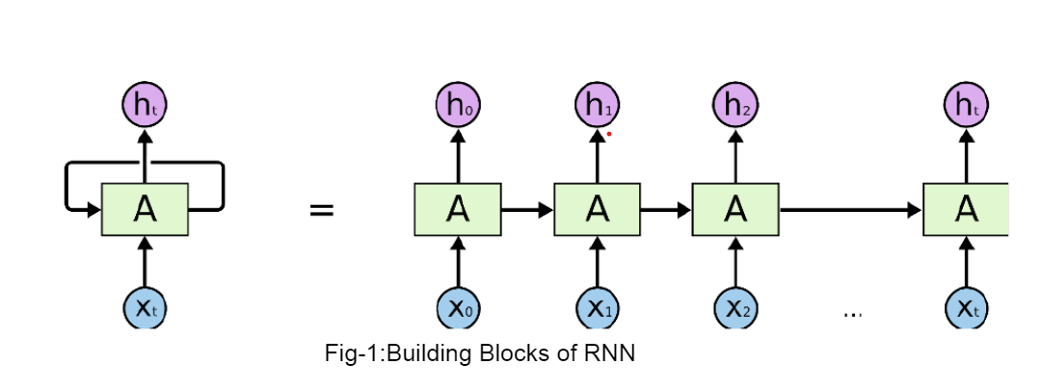
Building block of RNN
RNN uses a loop to remember the relation among all the previous outputs to predict the next output.
So first X(0) is the input and h(0) is the output. And also h(0) is input for the next step where the already existing input is x(1). Similarly output of this layer which is h(1), and the x(2) will be the input for the next step. This way it keeps remembering the context in training time
Here A is hidden layer activation function. Activation function takes decision for the output to be qualified or not for our result .Activation function is used based on my desired output pattern or type

Slide 7
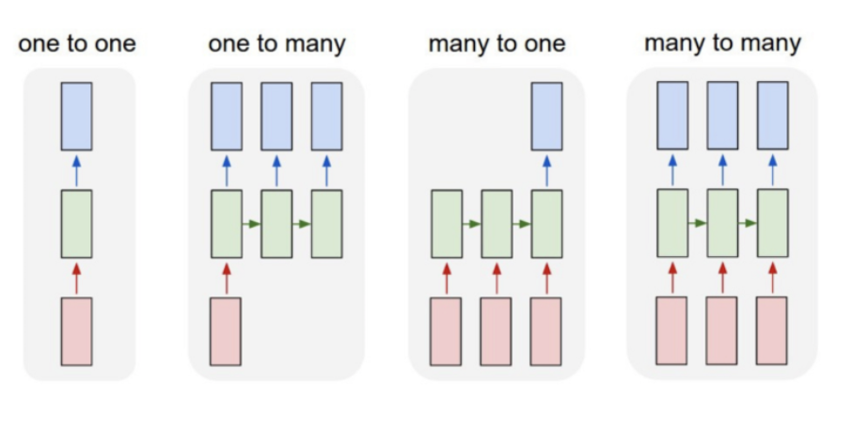
Types of RNN
One to one
One to many
Many to one
Many to many

Slide 8
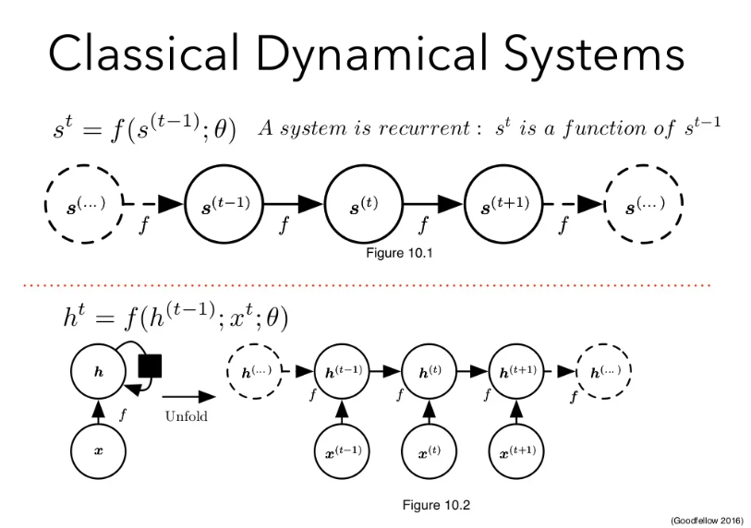

Slide 9
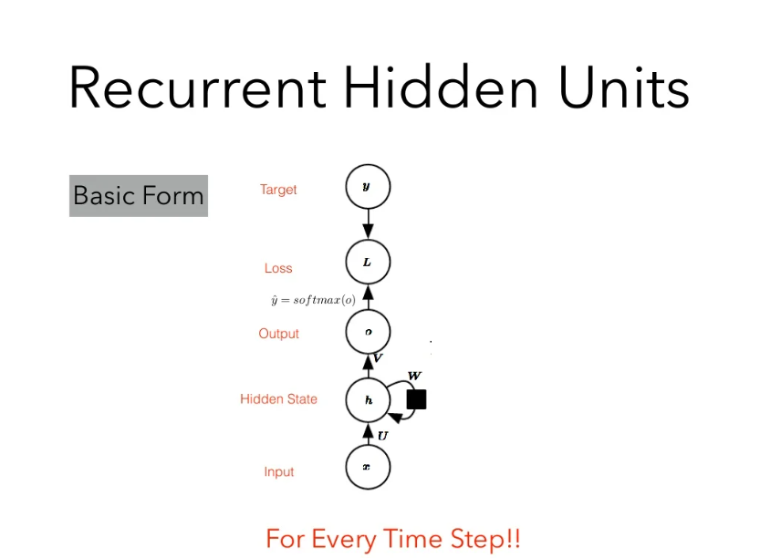

Slide 10
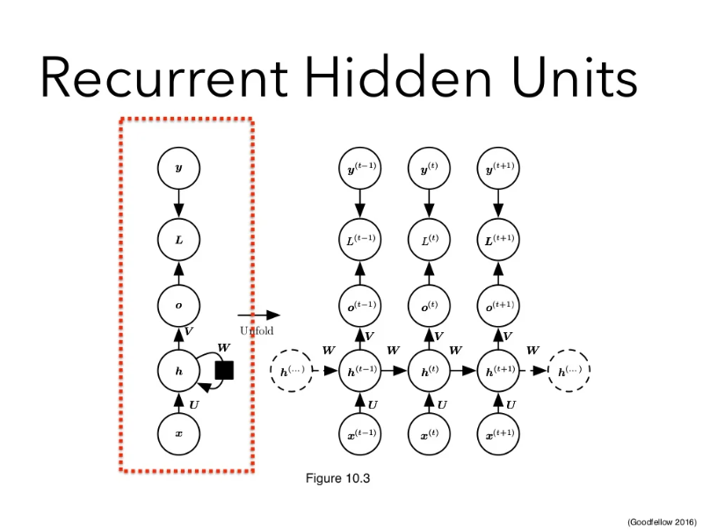

Slide 11
Backpropagation Through time(BPTT)
Regular (feedforward) backprop applied to RNN unfolded in time
Truncated BPTT approximation

Slide 12
Loss calculation:
At individual time step
After final computation

Slide 13
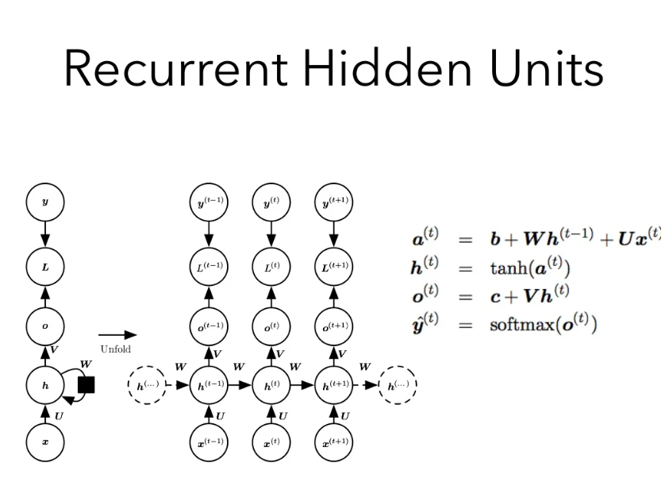

Slide 14
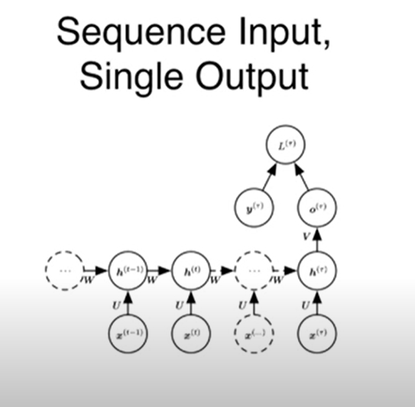
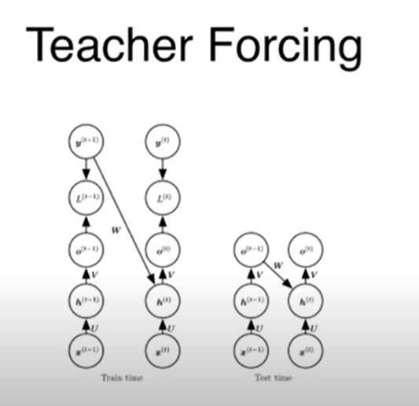
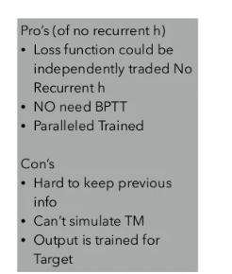

Slide 15
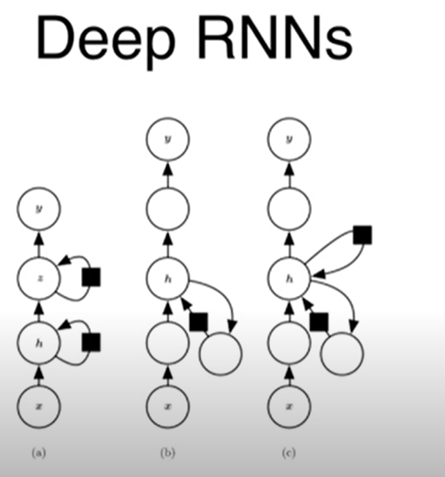
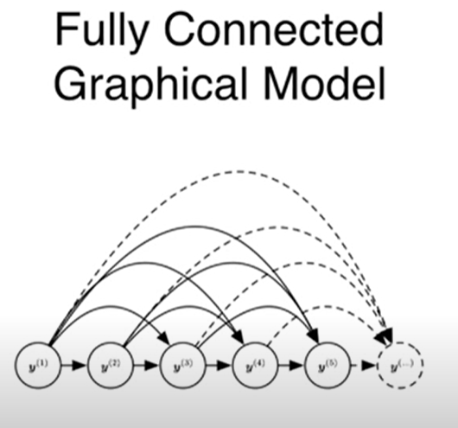

Slide 16
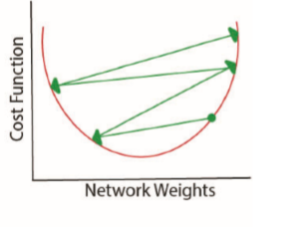
Issues with standard RNN
Two main issues :
Vanishing Gradient problem
when we use Sigmoid actv fn(0 to 1) over several backprop updates in weights is negligible.
Exploding Gradient problem
when we use ReLU actv fn (>1) over several backprop updates in weights will too much
Standard RNN can’t remember information if it has very large inputs.
So LSTM comes into Action.

Slide 17
LSTM(Long-short term memory)
A type of RNN architecture that addresses the vanishing/exploding gradient problem and allows learning of long-term dependencies
Recently risen to prominence with state-of-the-art performance in speech recognition, language modeling, translation, image captioning
Example: Today is holiday,so students ___ ____ in class.
Tomorrow is Monday, so students __ __ ____ in class.
Memory
Today | Holiday
Tomorrow | monday

Slide 18
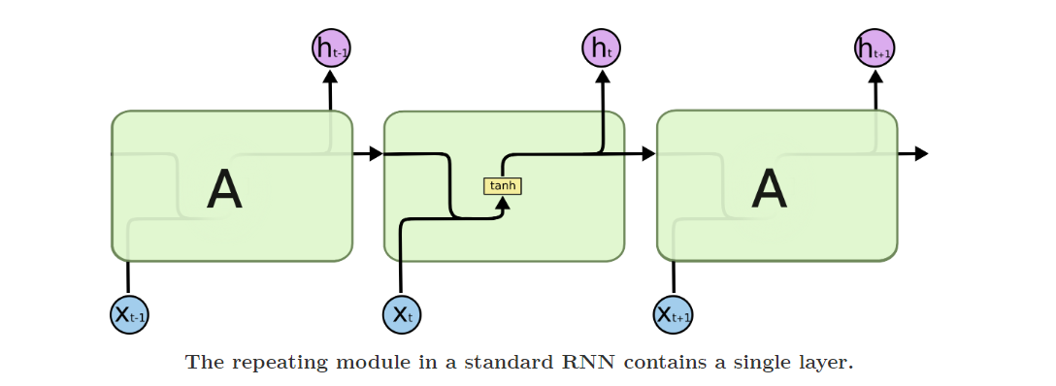
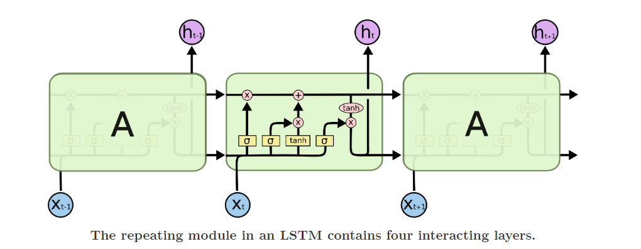
RNN vs LSTM

Slide 19
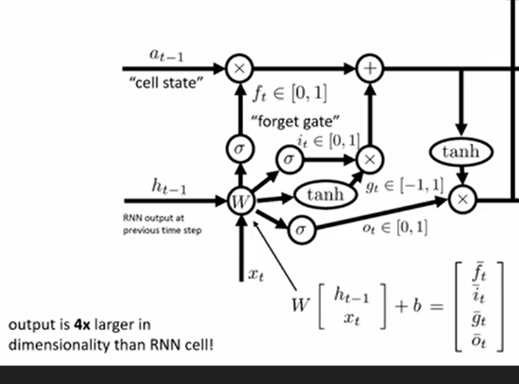

Slide 20
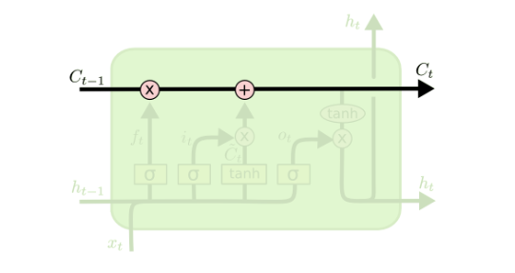
Cell State Vector
Represents the memory of the LSTM
Undergoes changes via forgetting of old memory (forget gate) and addition of new
memory (input gate)

Slide 21
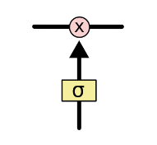
Gates
The LSTM does have the ability to remove or add information to the cell state, carefully regulated by structures called gates.
Gate: sigmoid neural net layer followed by pointwise multiplication operator
Gates control the flow of information to/from the memory
Gates are controlled by a concatenation of the output from the previous time step and the current input and optionally the cell state vector.

Slide 22
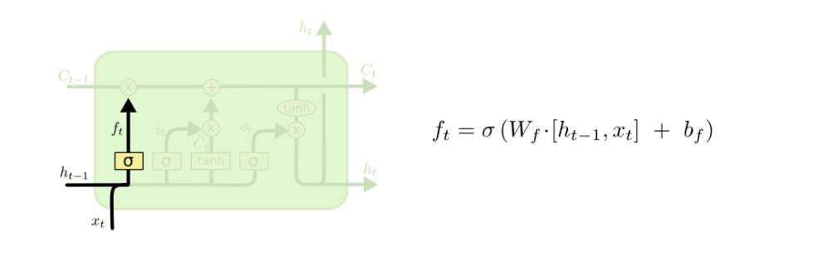
Forget Gate
Controls what information to throw away from memory

Slide 23
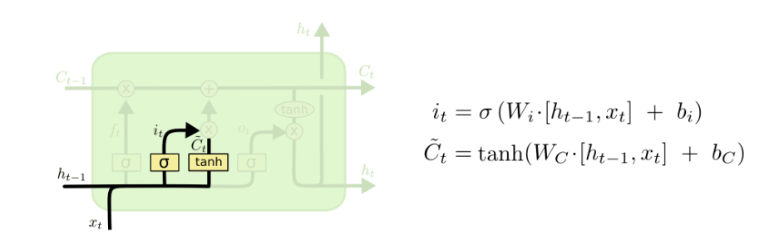
Input Gate
Controls what new information is added to cell state from current input

Slide 24
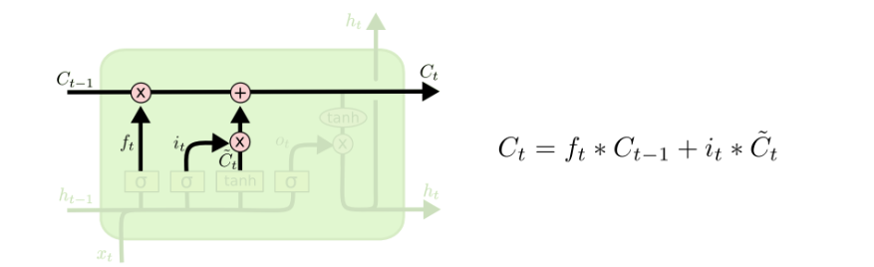
Memory Update
The cell state vector aggregates the two components (old memory via the forget gate and new memory via the input gate)

Slide 25
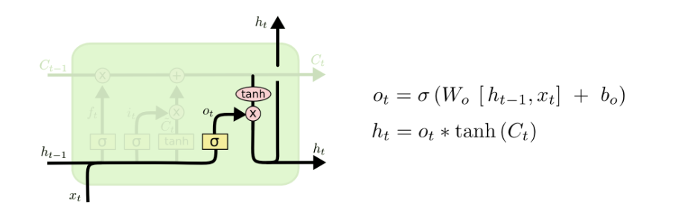
Output Gate
Conditionally decides what to output from the memory

Slide 26
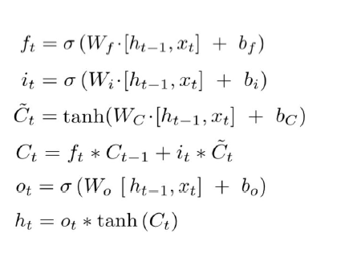
Summary

Slide 27
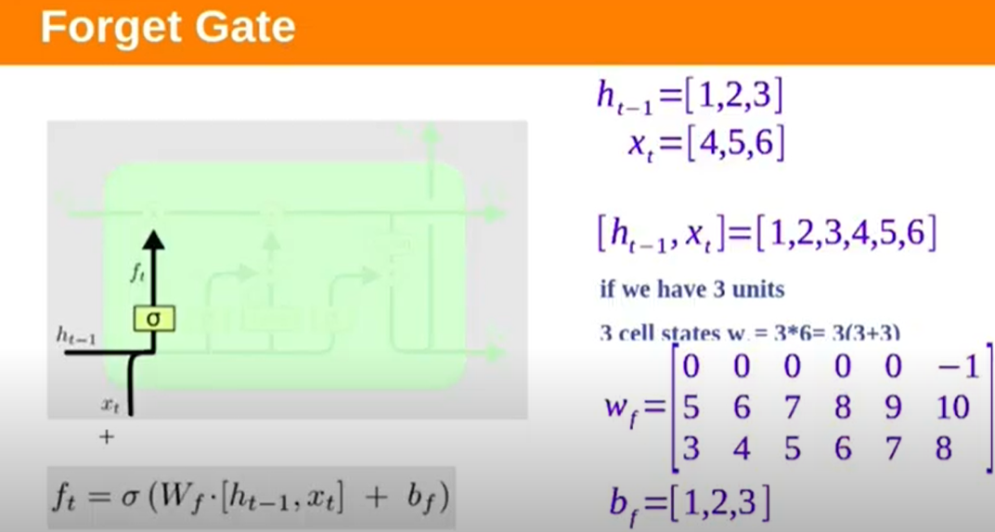

Slide 28
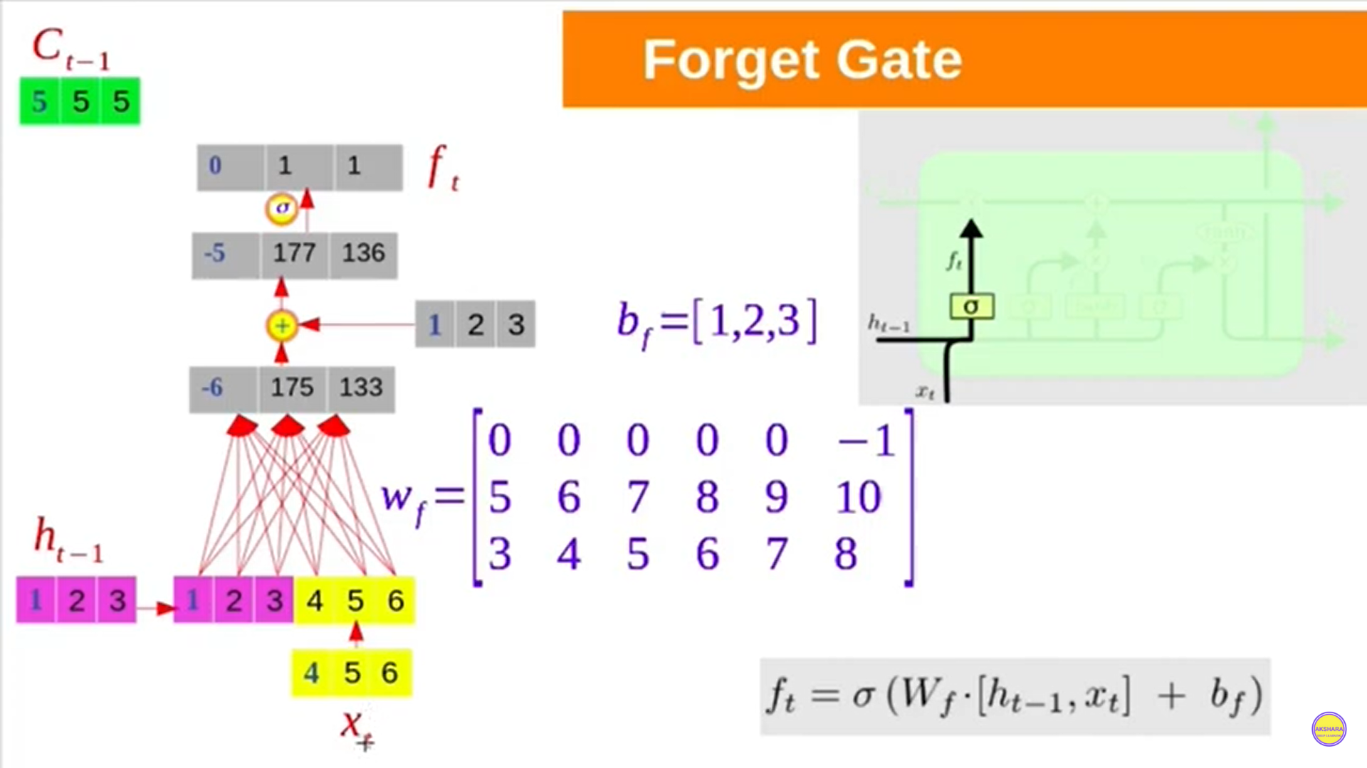

Slide 29
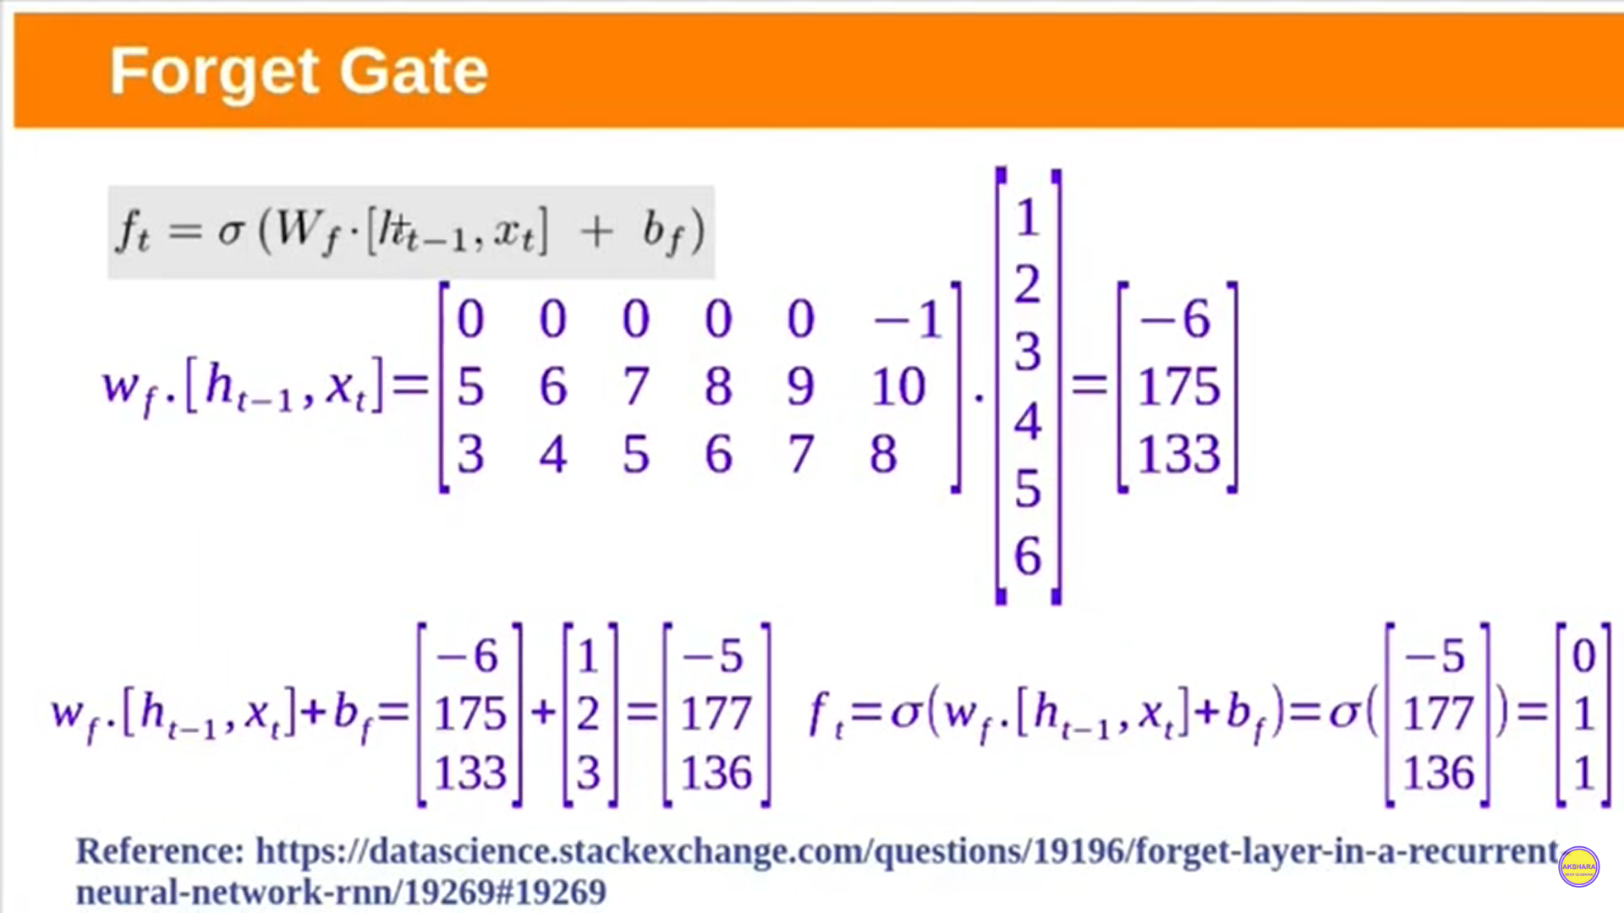

Slide 30
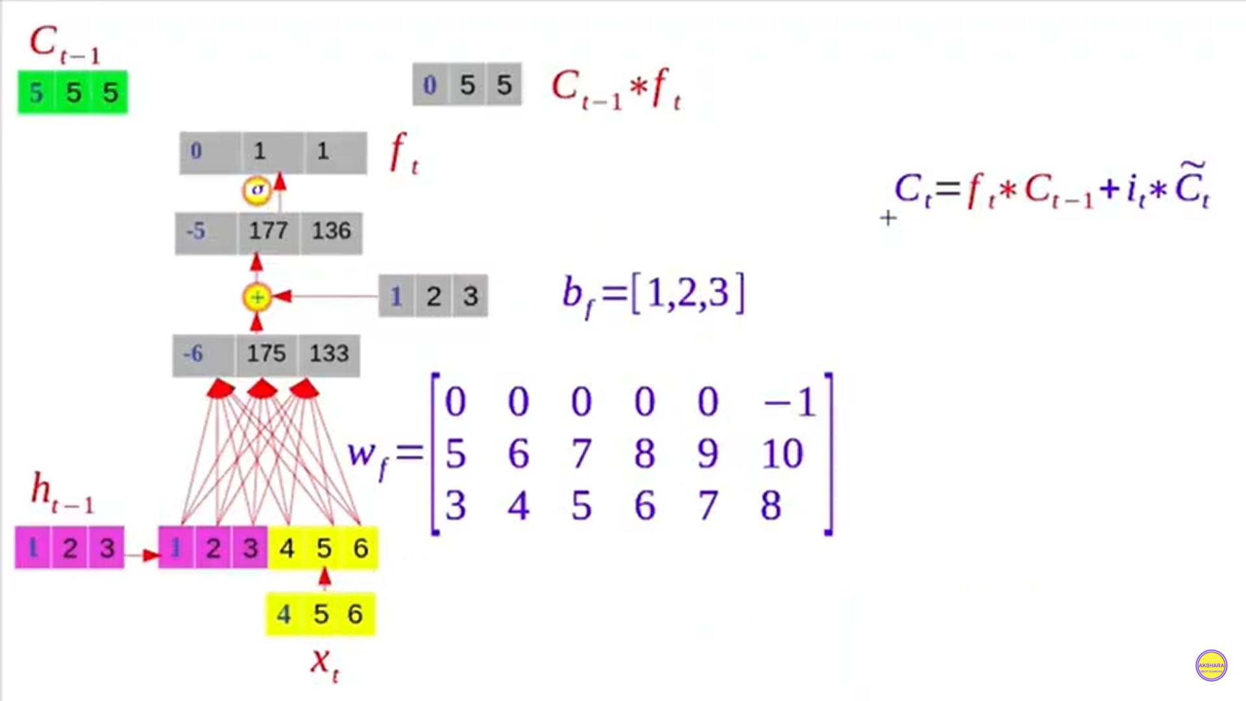

Slide 31
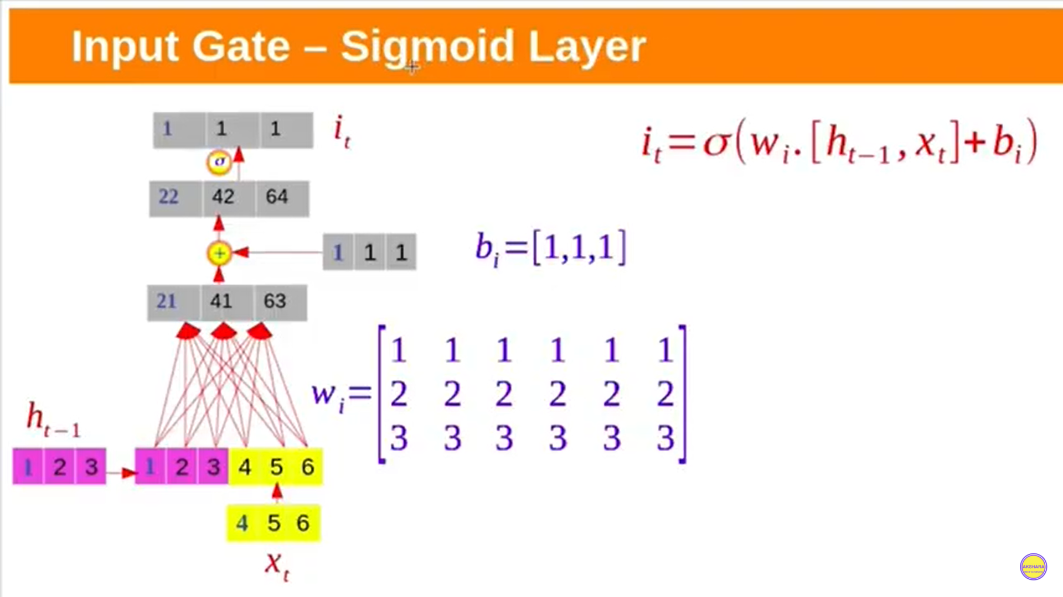

Slide 32
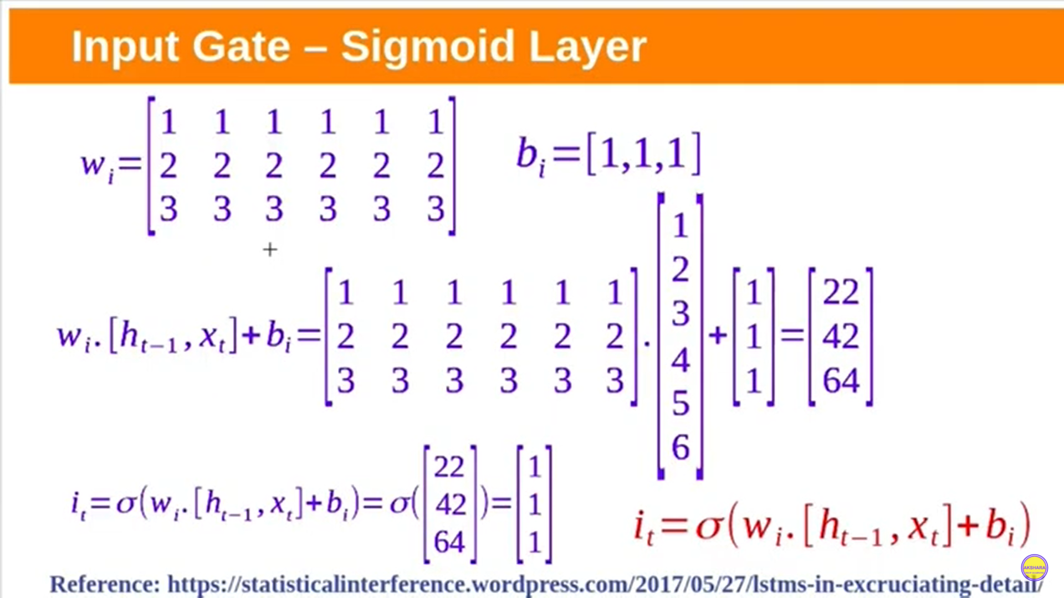

Slide 33
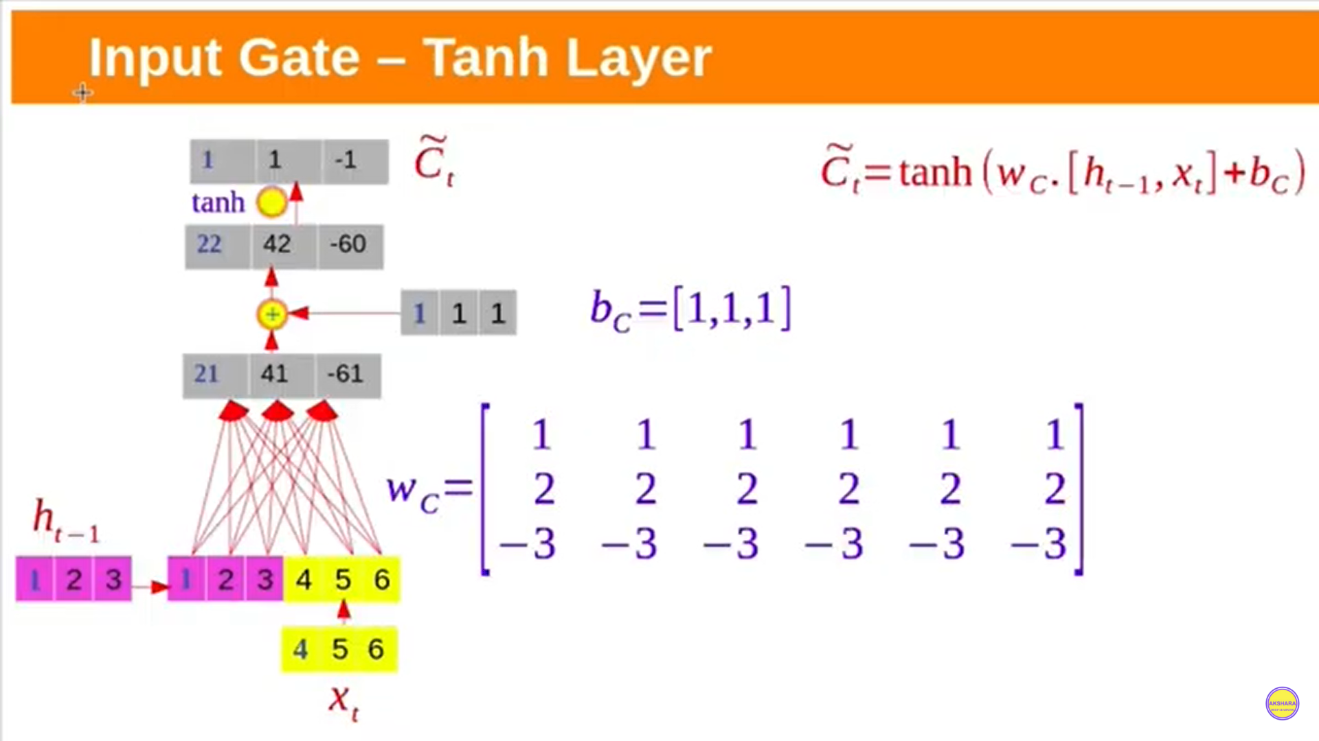

Slide 34
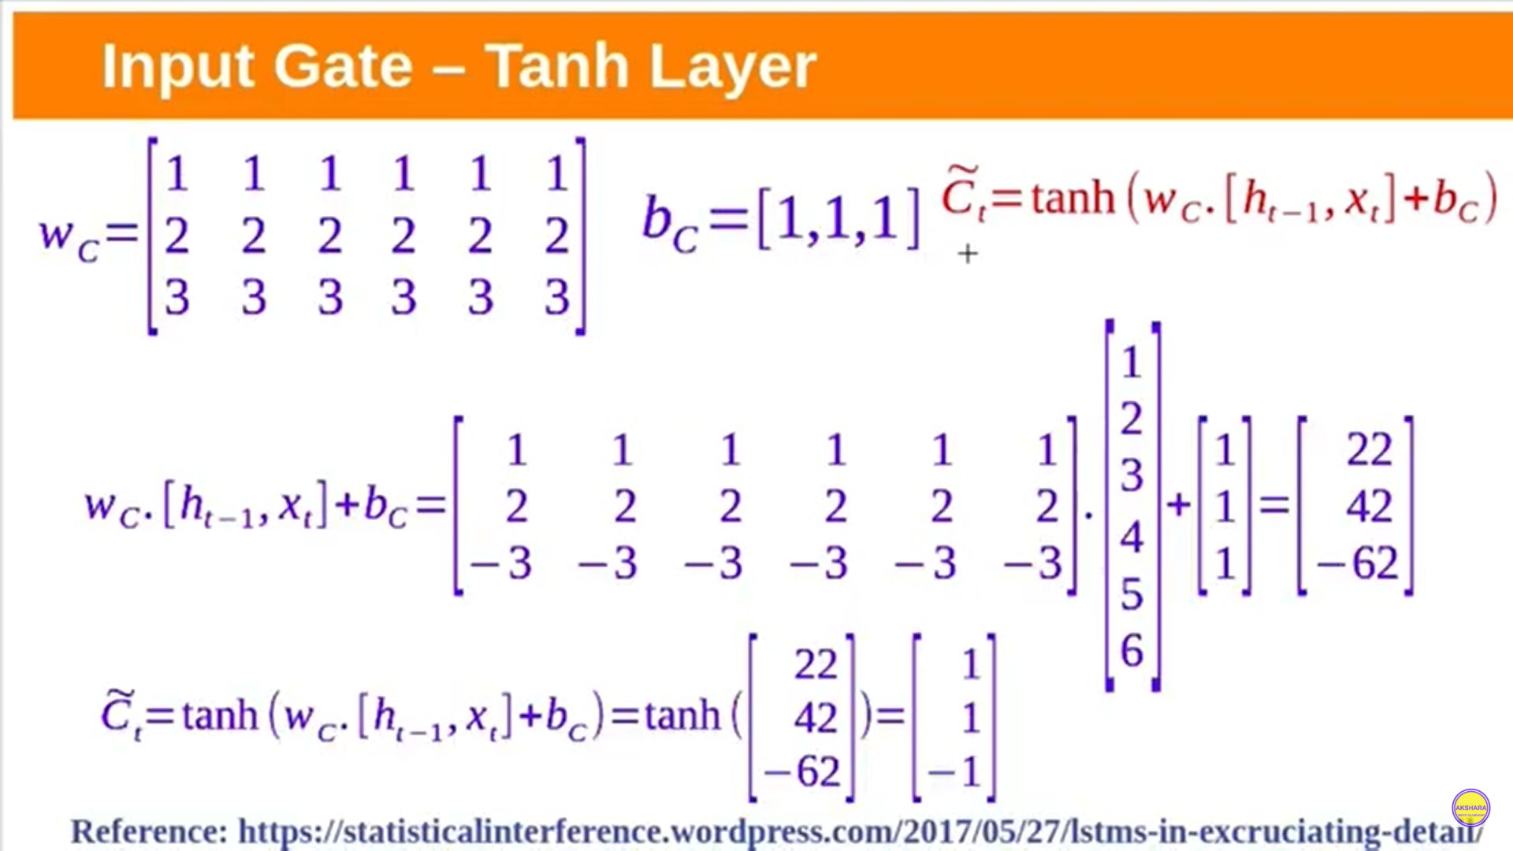

Slide 35
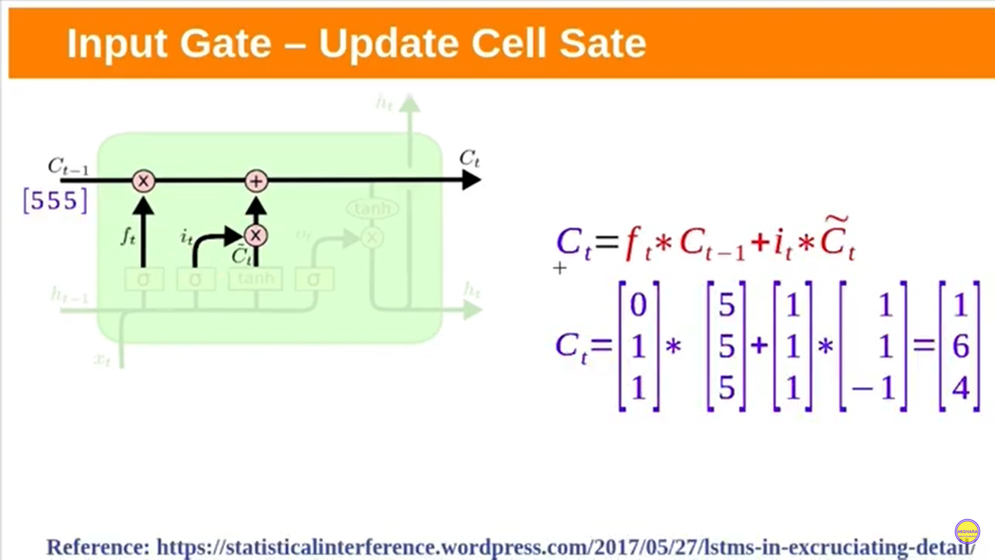

Slide 36
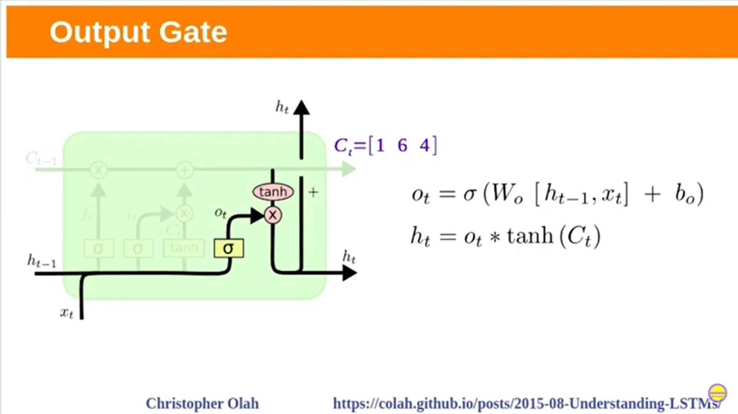

Slide 37
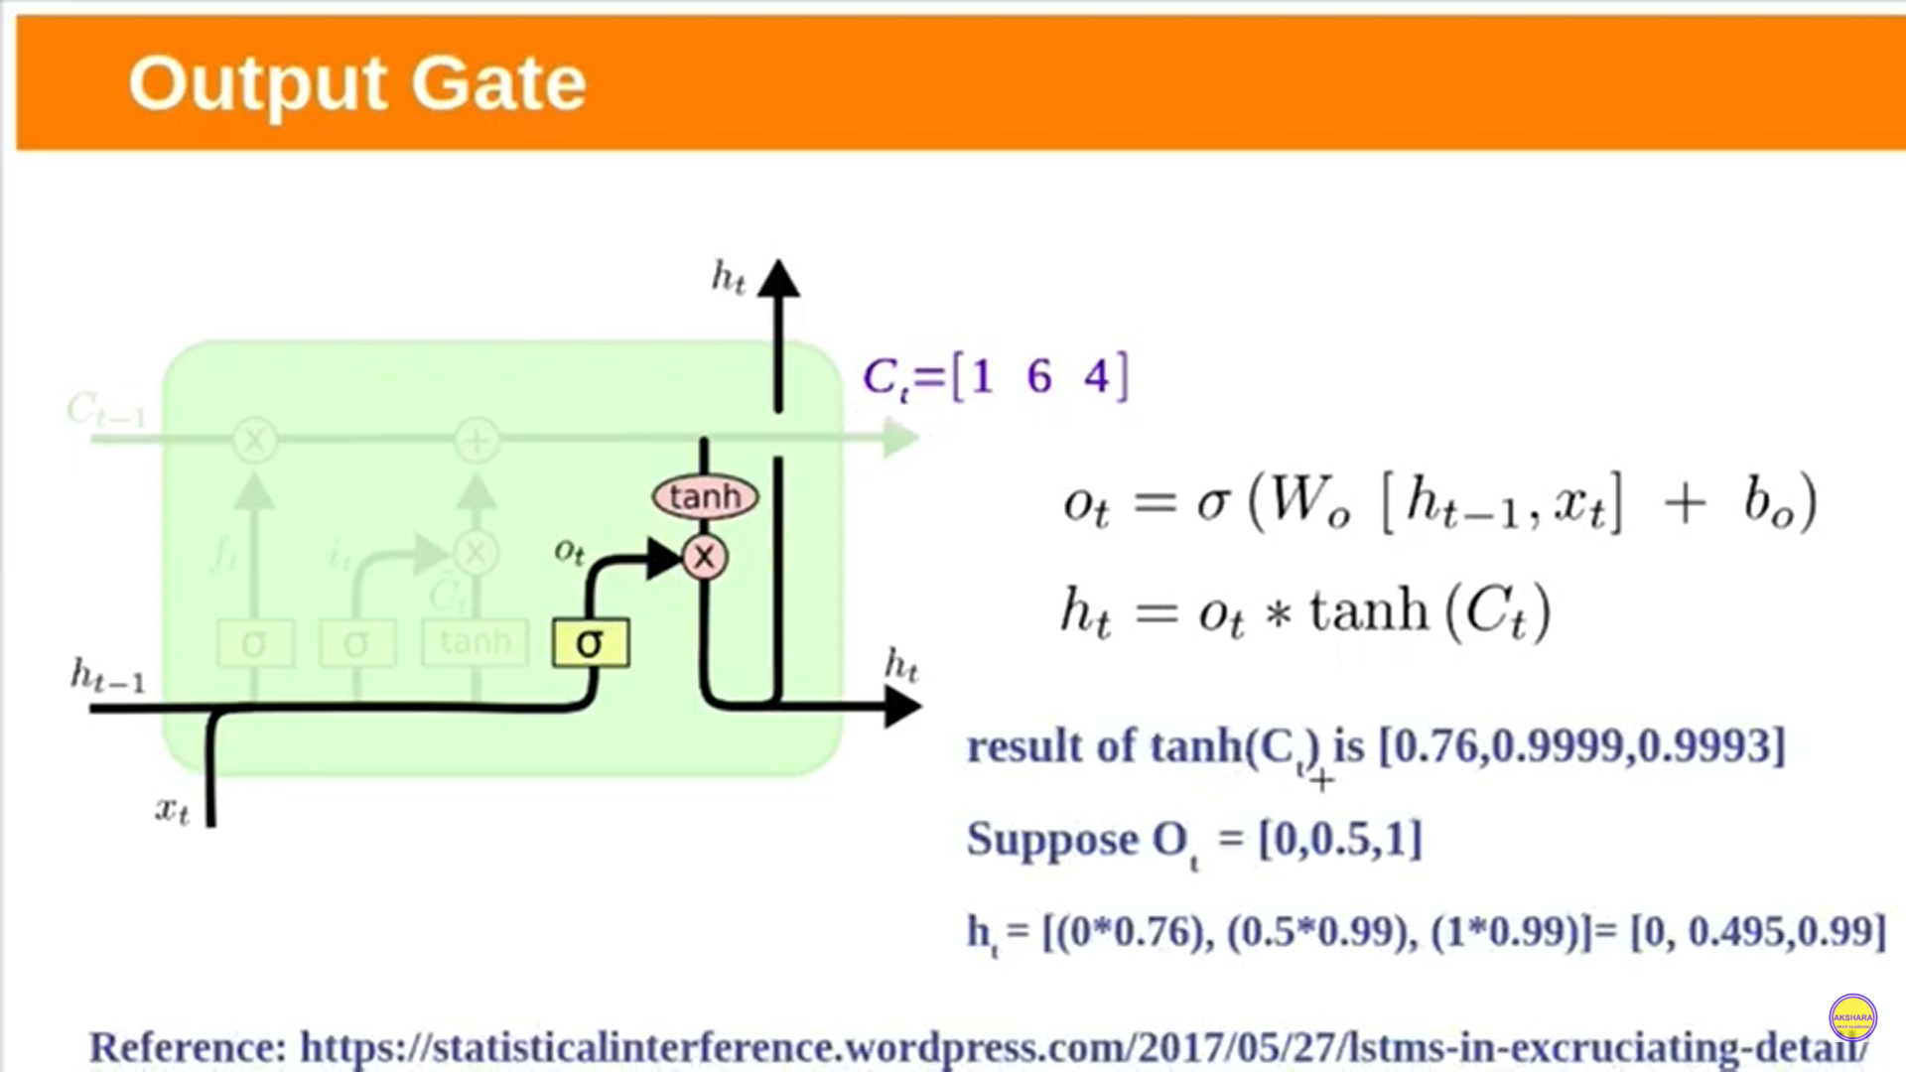

Slide 38
Reference material: https://colah.github.io/posts/2015-08-Understanding-LSTMs/

